Slide 1

Maximize Asset Uptime through Enterprise Field Asset Maintenance
Notes:
Welcome to today’s manufacturing roundtable focused on maximizing asset uptime through Enterprise Field Asset Maintenance. My name is Mike Peterson and I’ll be your host today.

Slide 2
Top 3 Areas to Think About
Think beyond just connecting your assets to the cloud
Long-term asset strategy plays a pivotal role in your factory agility
How an integrated platform leveraging AI, ML & Mixed Reality can be a central strategy to help overcome the skills gap in your plants
Notes:
So before I turn it over to Ali. Here are 3 things I want you to keep in mind during today’s content. Especially as you either embark on or continue your journey to maximize asset uptime
As you hear some of what’s shared, think beyond just connecting your assets to the cloud
Your long-term asset strategy plays a pivotal role in your factory agility
How an integrated platform leveraging AI, ML & Mixed Reality can be a central strategy to help overcome the skills gaps in your plants
So with that, let me turn it over to Ali who will talk about why we are investing in capabilities for you to deliver on the vision for Enterprise Field Asset Maintenance

Slide 3
Industry trends
IoT data to reduce unplanned downtime.
By 2024, 40% of OEMs will leverage field asset IoT data to reduce unplanned downtime 25%. ¹
Supporting new business models
By 2023, 20% of industrial equipment manufacturers will support EaaS with remote Industrial IoT capabilities, up from a current base of near zero. ²
Mixed reality improving productivity.
By 2023, 40% of organizations will blend virtual and physical experiences, leading to increased workforce productivity and customer reach.³
Quality management across the value chain.
By 2024, 75% of manufacturers will embed quality management across the value chain, reducing overall cost of quality by 25%. ⁴
40%
40%
75%
1 IDC FutureScape: Worldwide Manufacturing 2020 Predictions, # US45594819, Oct 2019.
2 Gartner®, Top 5 Strategic Business Trends in Manufacturing Industries for 2021, 4 June 2021.
3 Gartner®, Top 5 Strategic Technology Trends in Manufacturing Industries for 2021, 4 June 2021.
4 IDC Futurescape worldwide manufacturing 2021 predictions, #US46912620, Oct 2020.
GARTNER is a registered trademark and service mark of Gartner, Inc. and/or its affiliates in the U.S. and internationally and is used herein with permission. All rights reserved.
Notes:
By 2024, 40% of OEMs will leverage field asset IoT data to reduce unplanned downtime 25%. More and more businesses will move away from reactive and preventative maintenance programs that at expensive and less accurate to more predictive maintenance programs leveraging sensor data infused with AI powered insights to proactively mitigate catastrophic machine failures.
Equipment as a Service: By YE23, 20% of industrial equipment manufacturers will support EaaS with remote Industrial IoT capabilities up from a current base of near zero. Gartner 2021 Top Trends in Manufacturing Industries - Equipment as a Service creates the opportunity to shift business costs from asset ownership and capital expenditure (capex) to asset subscription and operating expenditure (opex). For example, connected products are integrated to automate the procurement of consumables and spare parts, or with field service management systems so the products can schedule repair without intermediaries at the customer site or within the manufacturer. OEMs can leverage usage, data which can help improve equipment design.
By 2023, 40% of organizations will blend virtual and physical experiences, leading to increased workforce productivity and customer reach. Businesses will start to embark on the journey of anywhere operations to empower a dispersed workforce, harness a distributed infrastructure and serve a ubiquitous customer base. They will challenge the conventional wisdom that it’s necessary to be in a specific location, interacting face-to face, to maximize value and efficiency and envision employees, contractors, business partners, customers and end consumers working remotely from one another
Lastly as businesses aspire to reduce opex, improve throughput and provide a delightful customer experience, more and more manufacturers will embed quality management across the value chain, including the supply chain and field service, reducing overall cost of quality (COQ) by 25%.

Slide 4
What is Enterprise Field Asset Maintenance
Optimized maintenance strategy & processes leveraging Machine Learning, Mixed Reality and IoT to minimize disruptions in production, extend useful service life of assets and reduce operating costs
Used to plan, optimize, execute, and track the needed maintenance activities with the associated priorities, skills, materials, tools, and information to ensure that the assets are operational.

Slide 5
Business Challenges
Asset downtime results in not being able to produce the product in a timely manner, missing out on on-time delivery of customer orders
Reactive maintenance leads to expediting parts and overtime to fix broken assets
Direct costs
Indirect costs
Maintenance related costs are approximated to be 25% of overall operating costs.¹
An estimated 30% of maintenance costs are related to unnecessary expenditures associated to bad planning, overtime, spare parts inventory carrying costs, etc.²
Variable costs are associated with bad yield or poor quality due to equipment mal-function
Equipment availability and performance is a significant contributor to indirect value drivers
Quality issues can impact brand image and reduce profit margin
Late delivery decreases customer satisfaction and customer lifetime value
¹Komonen, 2002; Simoes et al., 2011
²Salonen and Deleryd, 2011
Notes:
¹Komonen, 2002; Simoes et al., 2011
²Salonen and Deleryd, 2011
There are 2 main business challenges:- Equipment breaks down halting your production which will delay customer orders. This could happen if the equipment is not maintained proactively or critical performance signals were missed or ignored. Asset over utilized etc
This results in expediting parts and labor overtimes which adds up over a period. You can see the direct & indirect maintenance costs due to reactive operations. 25% of overall cost is maintenance and approximately 30% of that cost is due to being reactive vs proactive. Other costs that are difficult to quantify but very commonly incurred are costs due to bad yield or faulty products due to equipment mal function , implications of late orders resulting in customer cancellations or customer going to competitor etc

Slide 6
Business Outcomes
Maximize longevity. Proactively maintain your assets from acquisition to retirement
Improve throughput, quality, and uptime. Improve Overall Equipment Effectiveness (OEE) of mission critical assets
Reduce costly machine failure and unpredicted shutdowns. Support various types of maintenance – Predictive, Preventative, Condition-based & Reactive
Transform your workforce. Better safety, faster training and higher quality of workmanship with intelligent tools and applications

Slide 7
Building business continuity through intelligent, unified systems
Distribution
Delivery
Manufacturing
Order orchestration
Planning
Procurement
Workforce Empowerment
Agility
Business continuity
Visibility
Unified & Intelligent Systems
Notes:
Dynamics 365 Supply Chain Management helps maximize the life of their critical assets by performing predictive maintenance to ensure 24x7 uptime and high throughput required to meet the ever-changing customer demand on time
Click 1:- Dynamics 365 business applications helps you meet critical business needs like enhancing supply chain visibility, gaining planning agility, and empowering workforce to ensure business continuity.
Click 2:- Dynamics 365 business applications can easily integrate with each other and other external systems. This way you can unify all the data in the azure data lake in real time, analyze this data and generate predictive insights using AI to proactively detect opportunities and risks
Click 3:- all the way from planning to procurement to manufacturing to distribution , order orchestration and delivery
-----------------------.
Details
Using Dynamics 365 and it’s connected technology enables business continuity.
Visibility – Dynamics 365 enables managers to plan with precision and lead with data-driven insights (e.g. more accurate resource allocation with predictive forecasting).
Agility – Dynamics 365 monitors large amounts of data behind the scenes to proactively detect opportunities and risks.
Workforce Optimization- Based on the opportunities and risks detected, Dynamics 365 proactively guides sellers toward the right buyer and next best actions to move relationships and deals forward

Slide 8
Microsoft Cloud
Most Competition
Microsoft 365
Microsoft Dynamics 365
Finance
Business Intelligence
Last generation data centers
Public Cloud B
Microsoft Power Platform
Marketing App
Public Cloud A
Low-Code Applications
Microsoft Azure
Last generation data centers
Collaboration Suite
Public Cloud C
Integration Tools
Identity, security, management, and compliance
Public Cloud B

Slide 9
Data Packages
OEE , Asset insights, automation
Vertical specific solution
Rapid Deployment Package
Dynamics 365 Asset Management Uniquely Composable
Training Libraries
Power BI
Maintenance Execution
Scheduling
Remote Monitoring
Power Apps
Data unification with common data system
Field
Service
Test Plans
IoT intelligence
Asset
Management
(Dynamics 365 Supply Chain Management)
Offering end-to-end solutions in a wide range of industries to meet specific business challenges
Accelerated deployment that supports changing business models for fast ROI
Power Automate
Power Virtual Agent
Remote Assist
Guides
ISV Apps
Business Processes
Configuration
Notes:
As you embark on the digital transformation journey to digitize different processes within in your supply chain, Dynamics 365 provides you the agility and foundation to transition to the cloud. Dynamics 365 solutions are uniquely composable. It can easily bolt on to your existing IT infrastructure to work with your legacy systems to start with. Lets say you start with digitizing your maintenance program – You can then use cognitive technologies to go from preventative to predictive maintenance. You can integrate with field service to ensure geographically dispersed assets are also up and running 24X7.
You can leverage mixed reality to improve workforce performance, provider faster training and improve workforce safety and compliance.
As you gain confidence, you can transform rest of your workloads all the way from planning to delivery and transition to a factory of the future. With seamless native integration, you can make data driven decision with confidence in real time from a single source of truth and improve the overall resilience of your supply chain. You can gain real time insights with embedded Power BI dashboards that will help with visualizing OEE of your entire factory.
With its modern architecture these solutions can be deployed much faster and can be packaged with vertical specific ISV solutions to align with your industry specific needs.
The

Slide 10

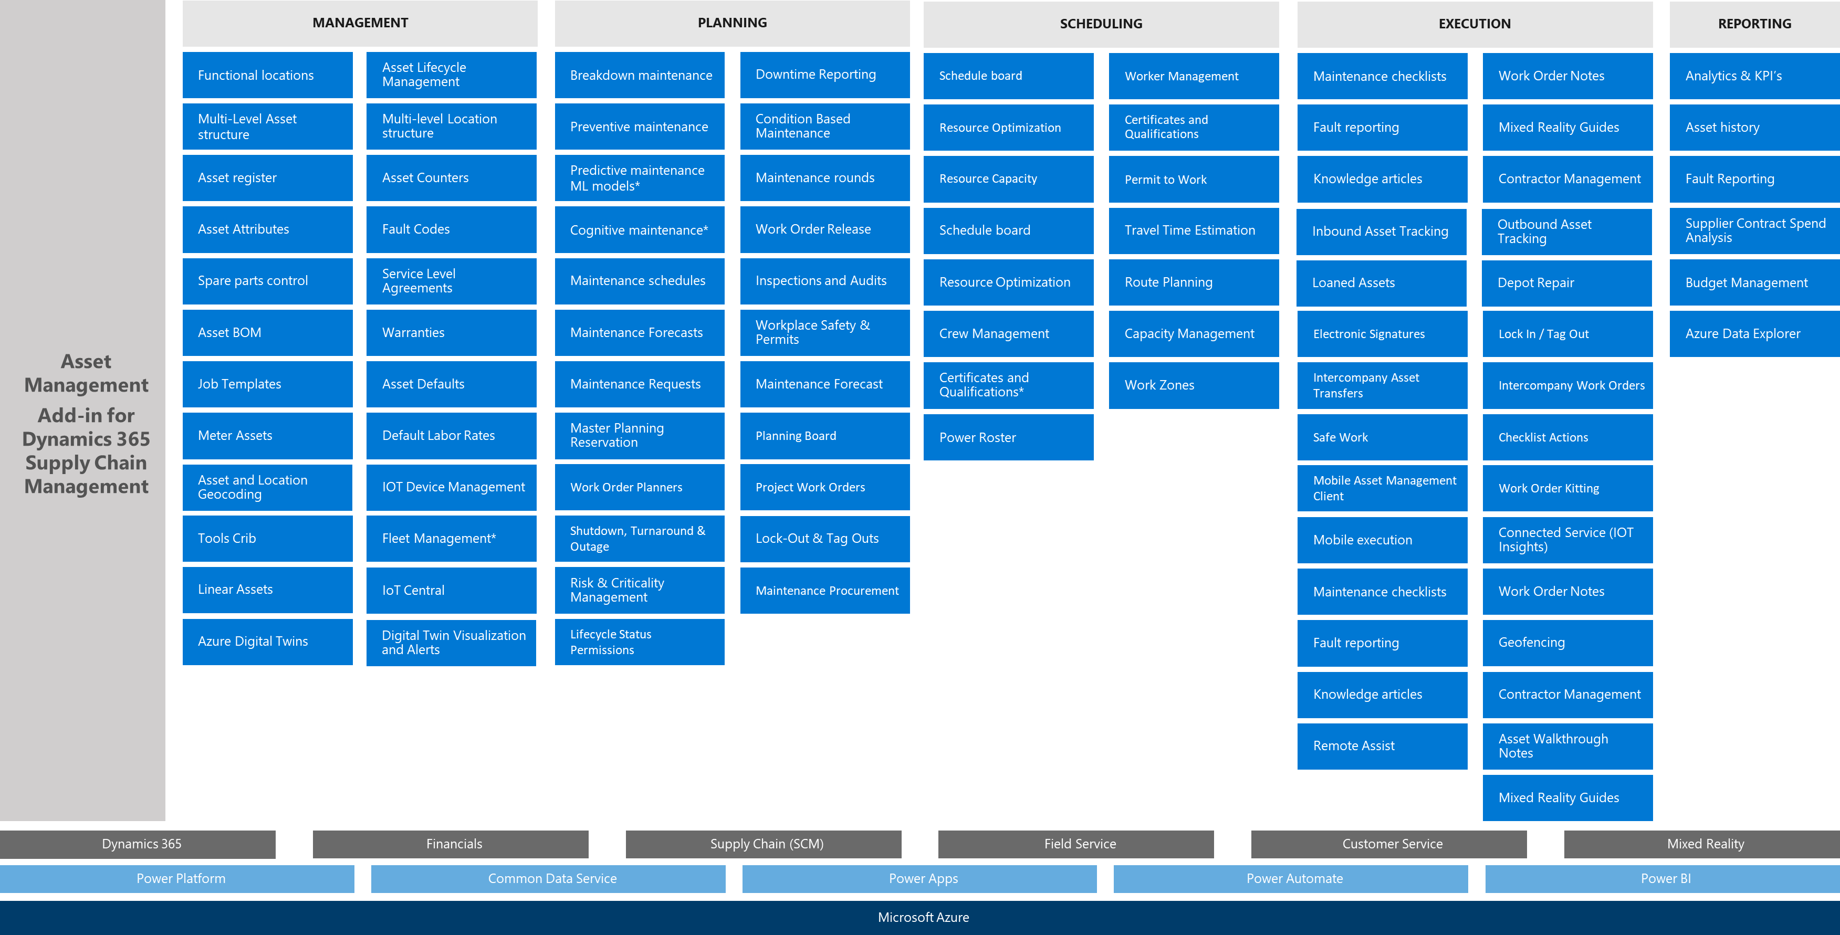
ALICIA
Maintenance Planner
Asset Management
Add-in for Dynamics 365 Supply Chain Management
MANAGEMENT
PLANNING
SCHEDULING
EXECUTION
REPORTING
Functional locations
Asset Lifecycle Management
Breakdown maintenance
Downtime Reporting
Schedule board
Worker Management
Maintenance checklists
Work Order Notes
Analytics & KPI’s
Multi-Level Asset structure
Multi-level Location structure
Preventive maintenance
Condition Based Maintenance
Resource Optimization
Certificates and Qualifications
Fault reporting
Mixed Reality Guides
Asset history
Asset register
Asset Counters
Predictive maintenance ML models*
Maintenance rounds
Resource Capacity
Permit to Work
Knowledge articles
Contractor Management
Fault Reporting
Asset Attributes
Fault Codes
Cognitive maintenance*
Work Order Release
Schedule board
Travel Time Estimation
Inbound Asset Tracking
Outbound Asset Tracking
Supplier Contract Spend Analysis
Spare parts control
Service Level Agreements
Maintenance schedules
Inspections and Audits
Resource Optimization
Route Planning
Loaned Assets
Depot Repair
Budget Management
Asset BOM
Warranties
Maintenance Forecasts
Workplace Safety & Permits
Crew Management
Capacity Management
Electronic Signatures
Lock In / Tag Out
Azure Data Explorer
Job Templates
Asset Defaults
Maintenance Requests
Maintenance Forecast
Certificates and Qualifications*
Work Zones
Intercompany Asset Transfers
Intercompany Work Orders
Meter Assets
Default Labor Rates
Master Planning Reservation
Planning Board
Power Roster
Safe Work
Checklist Actions
Asset and Location Geocoding
IOT Device Management
Work Order Planners
Project Work Orders
Mobile Asset Management Client
Work Order Kitting
Tools Crib
Fleet Management*
Shutdown, Turnaround & Outage
Lock-Out & Tag Outs
Mobile execution
Connected Service (IOT Insights)
Linear Assets
IoT Central
Risk & Criticality Management
Maintenance Procurement
Maintenance checklists
Work Order Notes
Azure Digital Twins
Digital Twin Visualization and Alerts
Lifecycle Status Permissions
Fault reporting
Geofencing
Knowledge articles
Contractor Management
Remote Assist
Asset Walkthrough Notes
Mixed Reality Guides
Dynamics 365
Financials
Supply Chain (SCM)
Field Service
Customer Service
Mixed Reality
Power Platform
Common Data Service
Power Apps
Power Automate
Power BI
Microsoft Azure
Enterprise Field Asset Maintenance Solution Overview

Slide 11













Enterprise Field Asset Maintenance Lifecycle Extended Journey Map
ASSET MANAGEMENT
CUSTOMER SERVICE
PROJECT MANAGEMENT
MAINTENANCE PLANNING
PROCUREMENT PLANNING
Asset Manager
Customer Service Manager
Project Planner
Maintenance Planner
Materials Manager
RICARDO
CASSIE
OSCAR
EDUARDO
MANISH
Ricardo is responsible for the maintenance of the maintenance asset details within the system. He maintains the assets, locations, and asset management defaults.
Cassie is responsible for all customer service interactions with customers, including maintenance requests that come directly from the customer.
Oscar oversees planning all the maintenance and service projects within the organization. He will create new projects for internal and external maintenance and plan the project budget and manage project changes.
Eduardo is responsible for planning the maintenance requests and work orders that may be initiated by a project or may be reactive work orders within the system. He will track all the maintenance work orders.
Manish is responsible for the procurement and sourcing of any materials that may be needed to perform the maintenance tasks that are on the maintenance plan. He will work with the suppliers to ensure the right parts are available on time.
FIXED ASSET AQUISITION
WORK ORDER EXECUTION
RESOURCE SCHEDULING
RESOURCE MANAGEMENT
INVENTORY MANAGEMENT
Fixed Asset Manager
Field Engineer
Service Scheduler
Human Resource Manager
Warehouse Manager
APRIL
PIERRE
LISA
MIA
JOHN
April manages all the Fixed Asset details that are related to the maintenance assets in the system. She ensures that the capital assets are tracked within the Fixed Assets module.
Pierre is where the tire meets the road. He will go wherever he is needed to perform the work orders that have been assigned to him.
Lisa oversees scheduling all the work orders that have been released to the field. She will ensure that the right engineers and technicians are sent to the right jobs, and in a timely manner.
Mia is responsible to the management of all the workers, contractors, and employees within the maintenance group. She ensures that all certifications and worker requirements are kept up to date.
John manages the main stores warehouse for the maintenance jobs. He will receive in and manage any new parts that have been ordered by procurement and will also ship the parts to the required maintenance locations as requested on the work orders.
PROJECT BILLING
REPORTING AND ANALYTICS
FIXED ASSET VALUATIONS
FIXED ASSET RETIREMENT
Billing Manager
Maintenance Planner
Accountant
Fixed Asset Manager
CHRIS
ALICIA
CLAIRE
APRIL
Chis oversees billing any customers that have commissioned us to perform maintenance on customer owned assets. He will take the chargeable costs and try to get paid for the work.
Alicia analyzes all the information that is created within the Asset Management process and distills the information down to reports and analytics that the company can use.
Claire crunches all the costs that have been incurred by the maintenance work orders and decides if the asset value has been affected. She may increase of decrease the value of assets based on the work done on them.
April also tracks the decommissioning of assets that are no longer in use or owned by the organization.

Slide 12













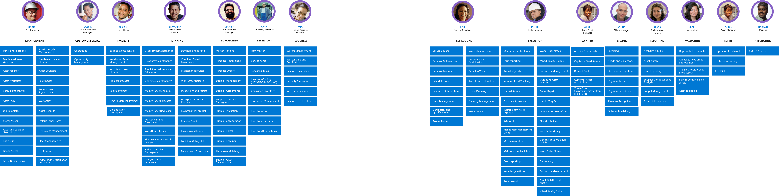
RICARDO
CASSIE
OSCAR
EDUARDO
MANISH
JOHN
MIA
LISA
PIERRE
APRIL
CHRIS
ALICIA
CLAIRE
APRIL
PRAKASH
Asset Manager
Customer Service Manager
Project Planner
Maintenance Planner
Procurement Manager
Inventory Manager
Human Resource Manager
Service Scheduler
Field Engineer
Fixed Asset Manager
Billing Manager
Maintenance Planner
Accountant
Asset Manager
IT Manager
MANAGEMENT
CUSTOMER SERVICE
PROJECTS
PLANNING
PURCHASING
INVENTORY
RESOURCES
SCHEDULING
EXECUTION
ACQUIRE
BILLING
REPORTING
VALUATION
RETIRE
INTEGRATION
Functional locations
Asset Lifecycle Management
Quotations
Budget & cost control
Breakdown maintenance
Downtime Reporting
Master Planning
Item Master
Worker Management
Schedule board
Worker Management
Maintenance checklists
Work Order Notes
Acquire Fixed assets
Invoicing
Analytics & KPI’s
Depreciate fixed assets
Dispose off fixed assets
AM+FS Connect
Multi-Level Asset structure
Multi-level Location structure
Opportunity Management
Installation Project Management
Preventive maintenance
Condition Based Maintenance
Purchase Requisitions
Service Items
Worker Skills and Certifications
Resource Optimization
Certificates and Qualifications
Fault reporting
Mixed Reality Guides
Capitalize Fixed Assets
Credit and Collections
Asset history
Capitalize fixed asset improvements
Electronic reporting
Asset register
Asset Counters
Work Breakdown Structures
Predictive maintenance ML models*
Maintenance rounds
Purchase Orders
Serialized Items
Resource Calendars
Resource Capacity
Permit to Work
Knowledge articles
Contractor Management
Derived Books
Revenue Recognition
Fault Reporting
Transfer, revalue, split Fixed assets
Asset Sale
Asset Attributes
Fault Codes
Project Forecasts
Cognitive maintenance*
Work Order Release
Supplier Management
Inventory Costing (LIFO/FIFO/MAC/WAC)
Capacity Management
Schedule board
Travel Time Estimation
Inbound Asset Tracking
Outbound Asset Tracking
Customer Asset Acquisition
Payment Terms
Supplier Contract Spend Analysis
Split & Combine fixed assets
Spare parts control
Service Level Agreements
Capital Projects
Maintenance schedules
Inspections and Audits
Supplier Agreements
Consigned Inventory
Worker Proficiency
Resource Optimization
Route Planning
Loaned Assets
Depot Repair
Create/Link Maintenance Asset from Fixed Asset
Payment Schedules
Budget Management
Asset Tax Books
Asset BOM
Warranties
Time & Material Projects
Maintenance Forecasts
Workplace Safety & Permits
Supplier Contract Management
Storeroom Management
Resource Geolocation
Crew Management
Capacity Management
Electronic Signatures
Lock In / Tag Out
Revenue Recognition
Azure Data Explorer
Job Templates
Asset Defaults
Collaboration Workspaces
Maintenance Requests
Maintenance Forecast
Supplier Evaluation
Inventory Zones
Certificates and Qualifications*
Work Zones
Intercompany Asset Transfers
Intercompany Work Orders
Subscription Billing
Meter Assets
Default Labor Rates
Master Planning Reservation
Planning Board
Supplier Collaboration
Inventory Transfers
Power Roster
Safe Work
Checklist Actions
Asset and Location Geocoding
IOT Device Management
Work Order Planners
Project Work Orders
Supplier Portal
Inventory Reservations
Mobile Asset Management Client
Work Order Kitting
Tools Crib
Fleet Management*
Shutdown, Turnaround & Outage
Lock-Out & Tag Outs
Supplier Receipts
Mobile execution
Connected Service (IOT Insights)
Linear Assets
IoT Central
Risk & Criticality Management
Maintenance Procurement
Three Way Matching
Maintenance checklists
Work Order Notes
Azure Digital Twins
Digital Twin Visualization and Alerts
Lifecycle Status Permissions
Supplier Asset Relationships
Fault reporting
Geofencing
Knowledge articles
Contractor Management
Remote Assist
Asset Walkthrough Notes
Mixed Reality Guides
Enterprise Field Asset Maintenance Lifecycle Key Personas Capabilities

Slide 13
RICARDO
CASSIE
OSCAR
EDUARDO
MANISH
JOHN
MIA
LISA
PIERRE
APRIL
CHRIS
ALICIA
CLAIRE
APRIL
PRAKASH
Asset Manager
Customer Service Manager
Project Planner
Maintenance Planner
Procurement Manager
Inventory Manager
Human Resource Manager
Service Scheduler
Field Engineer
Fixed Asset Manager
Billing Manager
Maintenance Planner
Accountant
Asset Manager
IT Manager
MANAGEMENT
CUSTOMER SERVICE
PROJECTS
PLANNING
PURCHASING
INVENTORY
RESOURCES
SCHEDULING
EXECUTION
ACQUIRE
BILLING
REPORTING
VALUATION
RETIRE
INTEGRATION
Functional locations
Asset Lifecycle Management
Quotations
Budget & cost control
Breakdown maintenance
Downtime Reporting
Master Planning
Item Master
Worker Management
Schedule board
Worker Management
Maintenance checklists
Work Order Notes
Acquire Fixed assets
Invoicing
Analytics & KPI’s
Depreciate fixed assets
Dispose off fixed assets
AM+FS Connect
Multi-Level Asset structure
Multi-level Location structure
Opportunity Management
Installation Project Management
Preventive maintenance
Condition Based Maintenance
Purchase Requisitions
Service Items
Worker Skills and Certifications
Resource Optimization
Certificates and Qualifications
Fault reporting
Mixed Reality Guides
Capitalize Fixed Assets
Credit and Collections
Asset history
Capitalize fixed asset improvements
Electronic reporting
Asset register
Asset Counters
Work Breakdown Structures
Predictive maintenance ML models*
Maintenance rounds
Purchase Orders
Serialized Items
Resource Calendars
Resource Capacity
Permit to Work
Knowledge articles
Contractor Management
Derived Books
Revenue Recognition
Fault Reporting
Transfer, revalue, split Fixed assets
Asset Sale
Asset Attributes
Fault Codes
Project Forecasts
Cognitive maintenance*
Work Order Release
Supplier Management
Inventory Costing (LIFO/FIFO/MAC/WAC)
Capacity Management
Schedule board
Travel Time Estimation
Inbound Asset Tracking
Outbound Asset Tracking
Customer Asset Acquisition
Payment Terms
Supplier Contract Spend Analysis
Split & Combine fixed assets
Spare parts control
Service Level Agreements
Capital Projects
Maintenance schedules
Inspections and Audits
Supplier Agreements
Consigned Inventory
Worker Proficiency
Resource Optimization
Route Planning
Loaned Assets
Depot Repair
Create/Link Maintenance Asset from Fixed Asset
Payment Schedules
Budget Management
Asset Tax Books
Asset BOM
Warranties
Time & Material Projects
Maintenance Forecasts
Workplace Safety & Permits
Supplier Contract Management
Storeroom Management
Resource Geolocation
Crew Management
Capacity Management
Electronic Signatures
Lock In / Tag Out
Revenue Recognition
Azure Data Explorer
Job Templates
Asset Defaults
Collaboration Workspaces
Maintenance Requests
Maintenance Forecast
Supplier Evaluation
Inventory Zones
Certificates and Qualifications*
Work Zones
Intercompany Asset Transfers
Intercompany Work Orders
Subscription Billing
Meter Assets
Default Labor Rates
Master Planning Reservation
Planning Board
Supplier Collaboration
Inventory Transfers
Power Roster
Safe Work
Checklist Actions
Asset and Location Geocoding
IOT Device Management
Work Order Planners
Project Work Orders
Supplier Portal
Inventory Reservations
Mobile Asset Management Client
Work Order Kitting
Tools Crib
Fleet Management*
Shutdown, Turnaround & Outage
Lock-Out & Tag Outs
Supplier Receipts
Mobile execution
Connected Service (IOT Insights)
Linear Assets
IoT Central
Risk & Criticality Management
Maintenance Procurement
Three Way Matching
Maintenance checklists
Work Order Notes
Azure Digital Twins
Digital Twin Visualization and Alerts
Lifecycle Status Permissions
Supplier Asset Relationships
Fault reporting
Geofencing
Knowledge articles
Contractor Management
Remote Assist
Asset Walkthrough Notes
Mixed Reality Guides
Enterprise Field Asset Maintenance Lifecycle Key Personas Capabilities

Slide 14
Enterprise Field Asset Maintenance Maturity Curve
Cognitive
Predictive
Cognitive maintenance (intelligent operation)
Connected
Predictive maintenance
Average or current state
❺
Autonomous actions are taken to ensure maximum asset utilization and efficiency. Maintenance is automatically scheduled in consideration of operating health and maintenance logistics including parts, consumables, tools, and resource availability
Condition-based maintenance (remote monitoring)
Increasing cost controls and incident responsiveness
❹
Remaining Useful Life (RUL) for critical components determines asset health and pairs efficient operating range measures, usage patterns and repair history to improve maintenance planning
Scheduled maintenance
(preventative maintenance)
❸
Condition is monitored continuously using operating parameters to assess health and indicate maintenance needs via real-time alerts
Reactive
(traditional break fix)
❷
Repairs and service based on a fixed schedule regardless of condition or meet regulation
❶
Repair prompted by store request
Increasing asset uptime, performance, and life

Slide 15
Enterprise Field Asset Maintenance Journey Reactive
Observation / Work Request
Confirm /
Approve
Perform Work
c
Work Order Created
Performance
Monitoring
Release Work
Update Asset
Capture Time and Materials
Scheduled
Procurement / SC Execution
Digital Hotspots
Submit request via Portal or IoT
Document versioning and integration
Collaboration on Solution
Digital signatures
Management of skills and compliance
Orchestration of Supply chain
Guided Process via HoloLens
Visibility on ETA, Duration & time to complete
Real time monitoring
Digital feedback loop for lessons learned
Notes:
One of the key tenets of Enterprise Field Asset Maintenance is that not all activity can be (neither should be) preventative or predictive. The key is how do we empower the front-line workers across the digital hotspots to minimize the down-time of equipment and achieve best-in-class MTTR (mean time to repair) metrics. Bots, IoT, Mobility and Augmented Reality technologies play a major role in this journey. For instance, a maintenance request can be initiated by a QC (Quality Control) specialist using Teams and a Maintenance Chat-bot, when she discovers an anomaly in an equipment while performing her day-to-day tasks. This will not require her to know anything about how to do this or filing a paperwork and taking o the engineering office, enabling the Maintenance Team to have immediate visibility of a potential issue to triage.

Slide 16
Enterprise Field Asset Maintenance Journey Preventative
Set Counters / Meters
Run PM
Sequence
Perform Work
c
Work Order
Calendar Created
Performance
monitoring
Release Work
Update Asset
Capture Time and Materials
Work Orders scheduled
Procurement
Digital Hotspots
Update Counters via IoT
Document versioning and integration
Collaboration on Solution
Digital signatures
Management of skills and compliance
Orchestration of Supply chain
Guided processes via HoloLens
Visibility on ETA, Duration & time to complete
Real time monitoring
Digital feedback loop for lessons learned
Notes:
When applicable using a preventative maintenance policy ensures a catastrophic failure never to occur. This requires performing inspections and preventative tasks based on a periodic or equipment counter driven schedule. Further cost savings can be recognized when assets can be monitored remotely via IoT Intelligence that will eliminate the need for sending technicians to check the counters or bringing down equipment at unnecessary intervals. Additionally by capturing the maintenance and condition data, analyst can review trend across quality, production and maintenance to optimize the maintenance plans.

Slide 17
Enterprise Field Asset Maintenance Journey Predivtive
Set Counters / Meters
c
Assess RUL
Release Work
Performance
Monitoring
Predict Failure
Update Asset
Procurement
Work Order
Calendar Created
Perform Work
Capture Time and Materials
Work Orders scheduled
Digital Hotspots
Update Counters via IoT
Document versioning and integration
Collaboration on Solution
Digital signatures
Management of skills and compliance
Orchestration of Supply chain
Guided processes via HoloLens
Visibility on ETA, Duration & time to complete
Real time monitoring
Digital feedback loop for lessons learned
Notes:
Ultimately intelligent and adaptive Machine Learning Models can be integrated into the overall system, that can predict potential failures based on the telemetry coming from sensors via IoT intelligence.

Slide 18
Enterprise Field Asset Maintenance Journey Cognitive
Establish connectivity
c
Discover & register
Release Work
Performance
Monitoring
Review and structure Assets
Update Asset
Procurement
Initiate Work Order
Perform Work
Capture Time and Materials
Bots assisted process automation
Digital Hotspots
OPC Twin provides discovery and registration of industrial devices
Bots assist technicians and engineers to make decisions
Digital signatures
Azure IoT Hub funnels telemetry to ML models
Management of skills and compliance
Guided processes via HoloLens
Visibility on ETA, Duration & time to complete
Real time monitoring
Digital feedback loop for lessons learned
Notes:
Ultimately intelligent and adaptive Machine Learning Models can be integrated into the overall system, that can predict potential failures based on the telemetry coming from sensors via IoT intelligence.

Slide 19








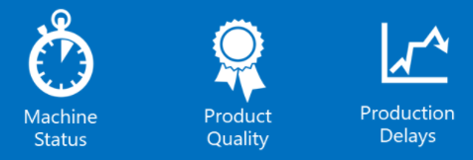









Enterprise Field Asset Maintenance Journey Cognitive Architecture
Ingestion & provisioning
Dynamics 365 Supply Chain Management
Assets
Hot Path
Actions
Azure Stream Analytics
Azure Cosmos DB
Azure Functions / API Apps
Create Asset Maintenance Requests
(Fin & Ops Logic Apps connector)
Azure IoT
Hub
Azure IoT Edge
Warm path
Insights
Sensor Data Intelligence Add-in
(Integrated with Azure IOT Hub)
Device Provisioning
Service
Time Series Insights
Azure Data Explorer
Azure Synapse
(SQL Serverless)
Predictive Maintenance
Machine
Learning Model
Cold path
Intelligence
Analytical Workspaces
(Power BI)
Azure Digital
Twins
Azure Synapse
(Datalake)
Azure Machine Learning
Predictive Maintenance Machine
Learning Model
Entity Store
(Azure Data Lake –
Common Data Model)

Slide 20
Maximize Asset Uptime and Efficiency
Reduce costly downtime
Reduce store operations cost
Notes:
Slide title: Maximize asset uptime and efficiency
Slide purpose: This slide introduces the third conversation pillar of this sales play and tees up the relevant use cases.
Key points:
Reduce costly downtime
Reduce store operations cost

Slide 21

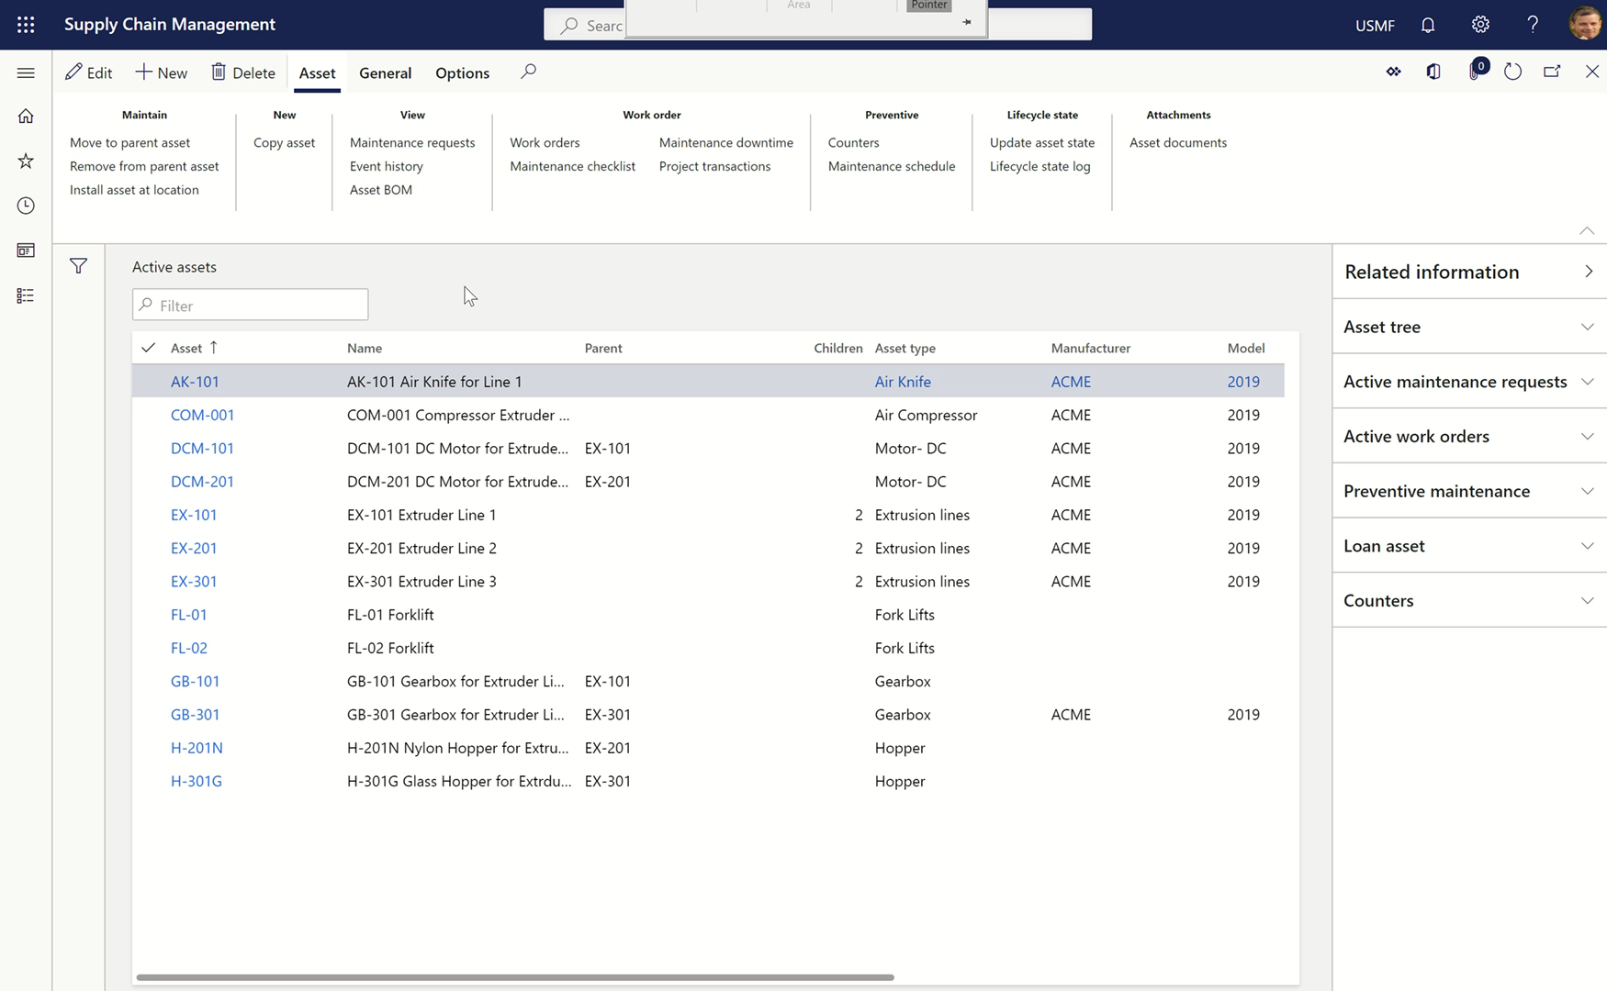
Maximize asset uptime and efficiency
Reduce costly downtime
Optimize maintenance plans
Schedule calendar entries based on selected maintenance plans, asset types, and assets
Create maintenance rounds for various assets, on which you need to carry out a similar task at regular intervals
View the maintenance schedule to see a list of all the expected preventive maintenance plans, maintenance requests, and maintenance rounds to be carried out
Driven from actionable insights from maintenance requests and activities
Dynamics 365 Asset Management
Notes:
Slide title: Optimize maintenance plans
Slide purpose: Reduce errors in production and extend the longevity of the assets by optimizing maintenance plans.
Key points:
Schedule calendar entries based on selected maintenance plans, asset types, and assets
Create maintenance rounds for various assets, on which you need to carry out a similar task at regular intervals
View the maintenance schedule to see a list of all the expected preventive maintenance plans, maintenance requests, and maintenance rounds to be carried out
Driven from actionable insights from maintenance requests and activities
Key products: Dynamics 365 Supply Chain Management, Asset Management
Additional sources:
1. Maintenance plans: https://docs.microsoft.com/en-us/dynamics365/supply-chain/asset-management/preventive-and-reactive-maintenance/maintenance-plans
2. Schedule maintenance plans: https://docs.microsoft.com/en-us/dynamics365/supply-chain/asset-management/preventive-and-reactive-maintenance/schedule-maintenance-plans
3. Maintenance rounds: https://docs.microsoft.com/en-us/dynamics365/supply-chain/asset-management/preventive-and-reactive-maintenance/maintenance-rounds

Slide 22
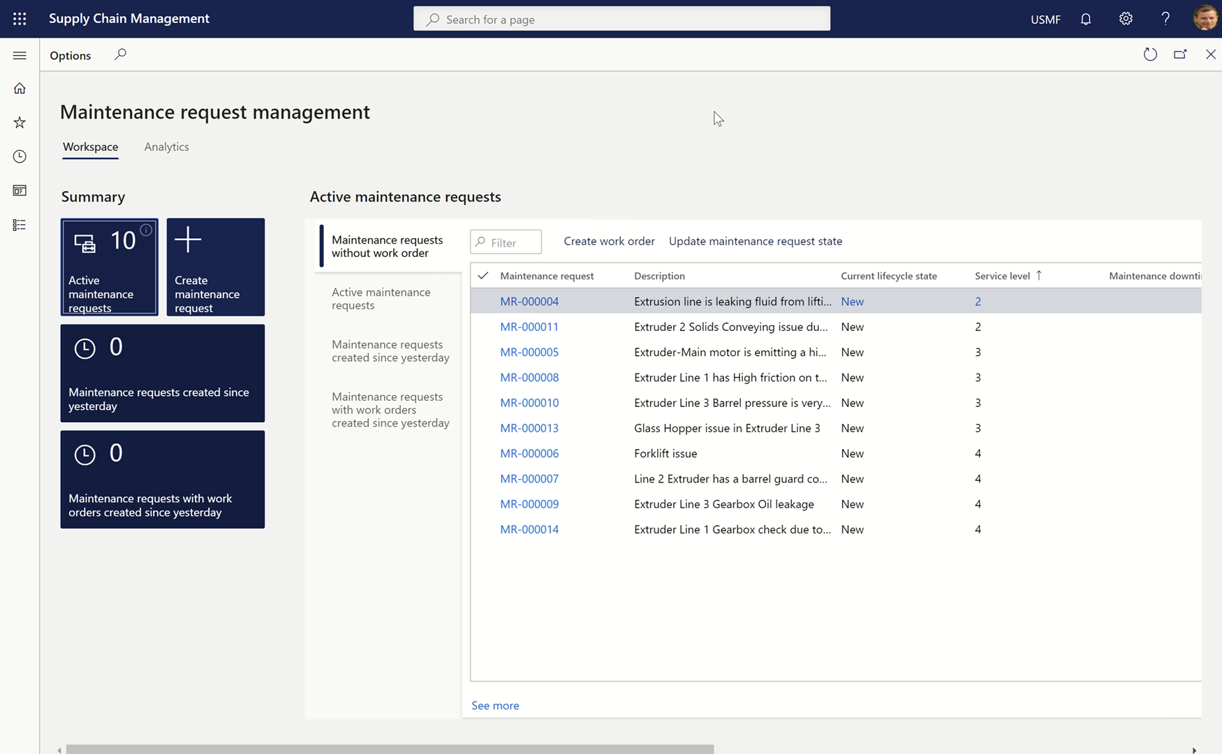
Maximize asset uptime and efficiency
Reduce costly downtime
Drive
maintenance insights
Predict when a device needs attention and automate self-healing or maintenance steps before any kind of problem
View product usage, issues, and repair history to diagnose problems and deliver predictive maintenance
Efficiently manage spare part stock holding driven by maintenance insights
Utilize Power Automate to create maintenance requests from IoT notifications
Dynamics 365 Asset Management
Notes:
Slide title: Drive maintenance insights
Slide purpose: Glean data-driven, maintenance insights with powerful dashboards and artificial intelligence.
Key points:
Predict when a device needs attention and automate self-healing or maintenance steps before any kind of problem
View product usage, issues, and repair history to diagnose problems and deliver predictive maintenance
Efficiently manage spare part stock holding driven by maintenance insights
Utilize Power Automate to create maintenance requests from IoT notifications
Key products: Dynamics 365 Supply Chain Management, Asset Management

Slide 23
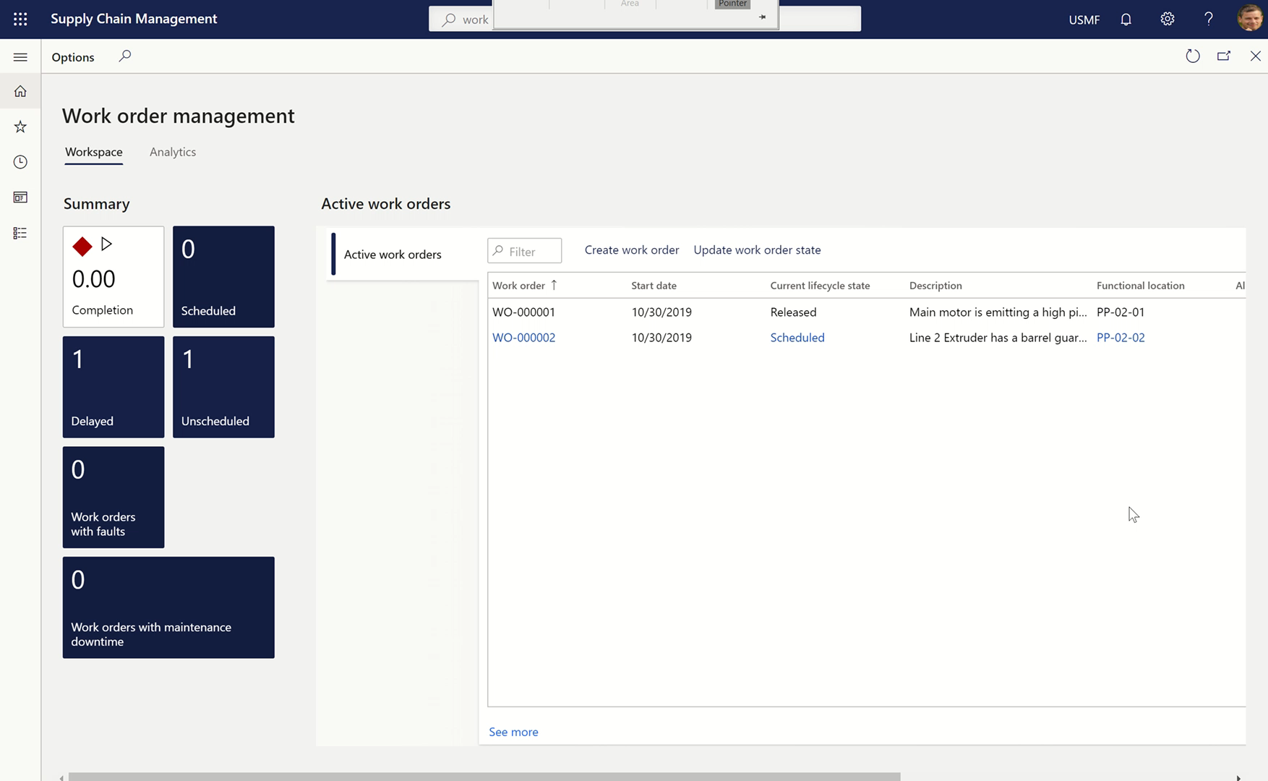
Maximize asset uptime and efficiency
Reduce costly downtime
Manage work orders
effectively
Work orders can be triggered by:
- Calendar based maintenance plans with auto creation
- Maintenance rounds
- Manually
- From maintenance requests
- Preventative maintenance jobs
Dynamics 365 Supply Chain Management
Notes:
Slide title: Manage work orders effectively
Slide purpose: Dynamics 365 Supply Chain Management enables users to easily view, update, and manage work orders from a single interface.
Key points:
Work orders can be triggered by:
- Calendar based maintenance plans with auto creation
- Maintenance rounds
- Manually
- From maintenance requests
- Preventative maintenance jobs
Key products: Dynamics 365 Supply Chain Management
Additional resources:
Work order types: https://docs.microsoft.com/en-us/dynamics365/supply-chain/asset-management/setup-for-work-orders/work-order-types
Work order project setup: https://docs.microsoft.com/en-us/dynamics365/supply-chain/asset-management/setup-for-work-orders/work-order-project-setup

Slide 24
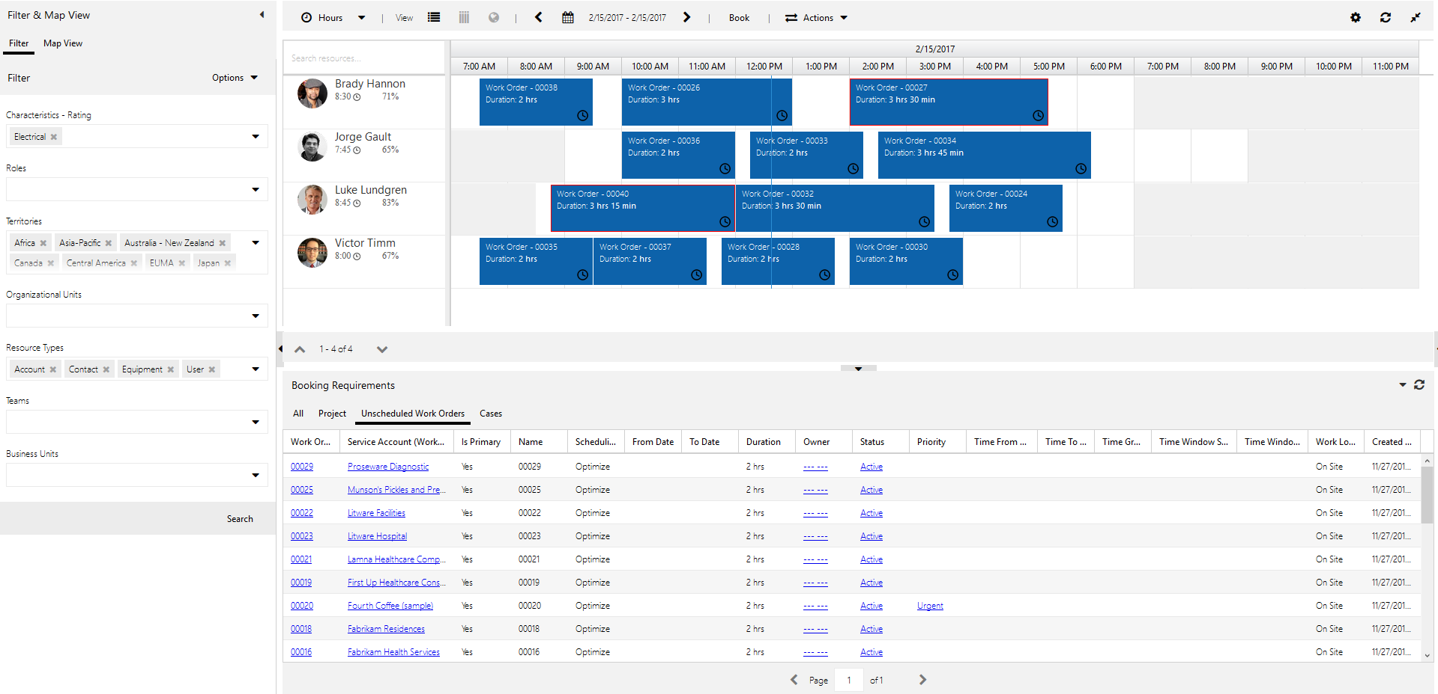
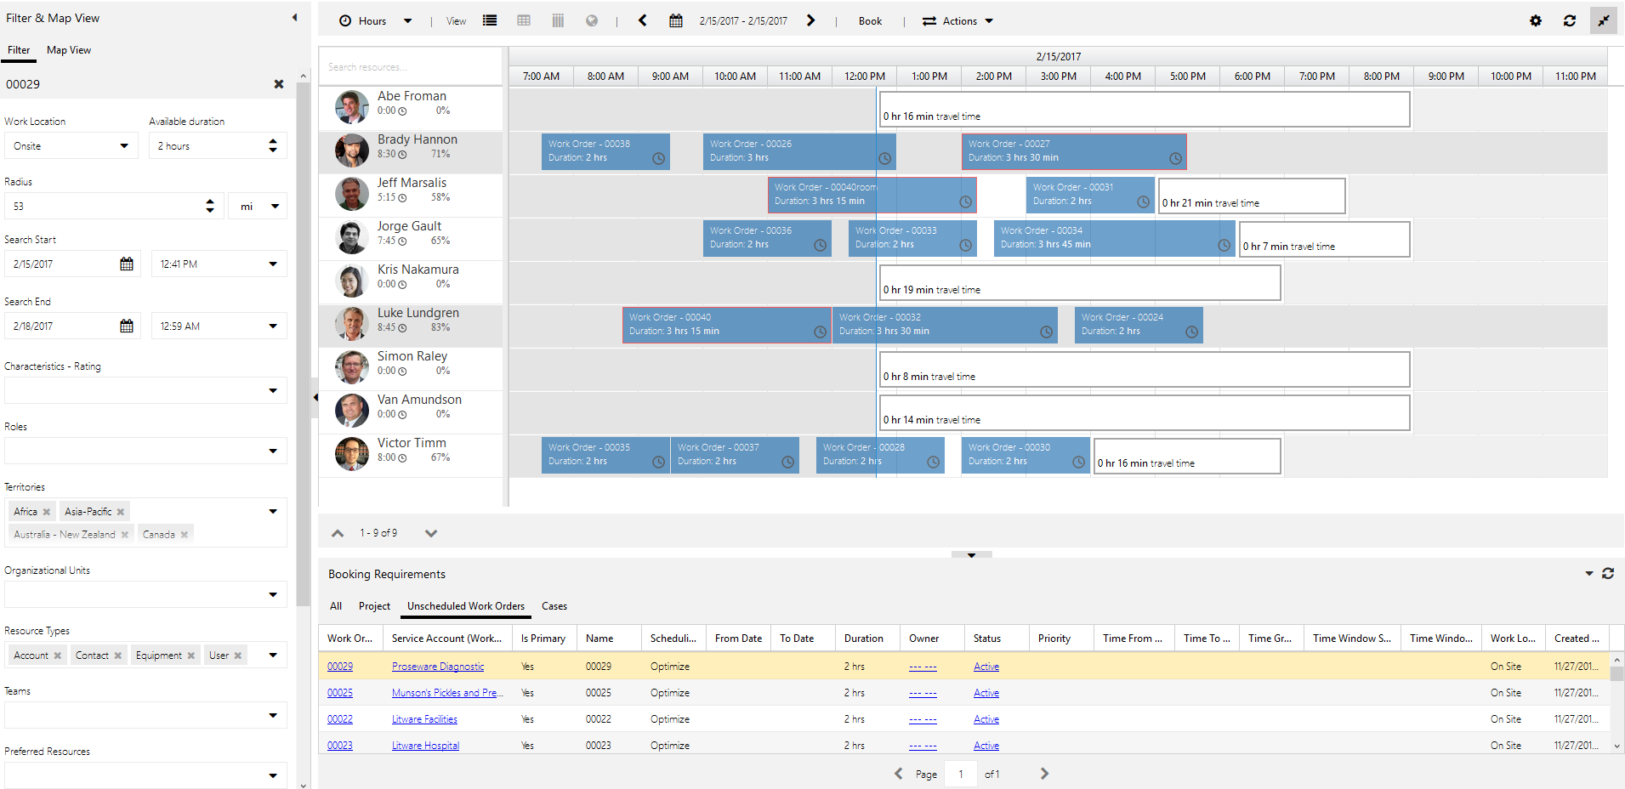
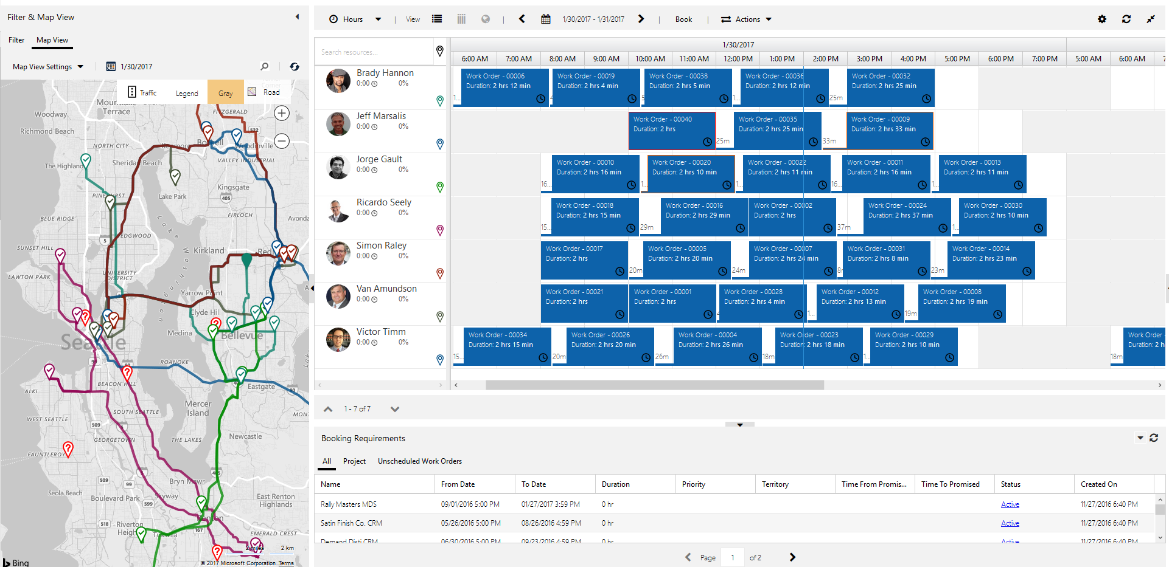
Maximize asset uptime and efficiency
Reduce costly downtime
Manual scheduling
Resource Scheduling Optimization
Scheduling assistant
Automate and
optimize scheduling
Resources can optionally be scheduled by utilizing the Common Data Service (CDS) and dual writes
Leverage the right scheduling option to meet your business needs: manual scheduling, scheduling assist, resource scheduling assistant (RSO)
RSO evaluates routes and automatically schedules work orders to minimize travel time and maximize working hours. The “engine” also responds to reschedules and cancellations. After automatically scheduling, dispatchers still have ability to manually override schedules as needed
Dynamics 365 Field Service
Notes:
Slide title: Automate and improve scheduling
Slide purpose: Resource Scheduling Optimization (RSO) enables customers to automate scheduling and drive more efficient operations.
Key points:
Resources can optionally be scheduled by utilizing CDS and dual writes
Resource Scheduling Optimization (RSO): evaluates routes and automatically schedules work orders to minimize travel time and maximize working hours. The “engine” also responds to reschedules and cancellations. After automatically scheduling, dispatchers still have ability to manually override schedules as needed
Automatically create a schedule for the appropriate resource (a resource can be a person or a non-human asset) in SharePoint, while simultaneously optimizing appointment setting for travel time, mileage, and many other constraints
Key products: Dynamics 365 Field Service
- Resource Scheduling Optimization is an add-on capability for the Field Service application. Resource Schedule Optimization is licensed per resource included in the optimization process and will typically be accessed by a scheduler or dispatcher user who will designate any number of resources to be included. Resources may be individuals, such as field technicians or other human resources. The add-on license allows for unlimited use of schedule optimization, which may be on a regular cadence such as daily or weekly, or ad-hoc. A Field Service license is required for managing the Resource Schedule Optimization.

Slide 25
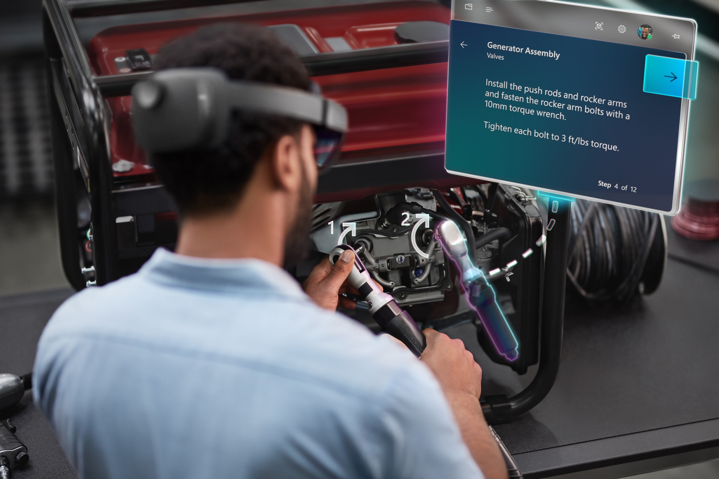
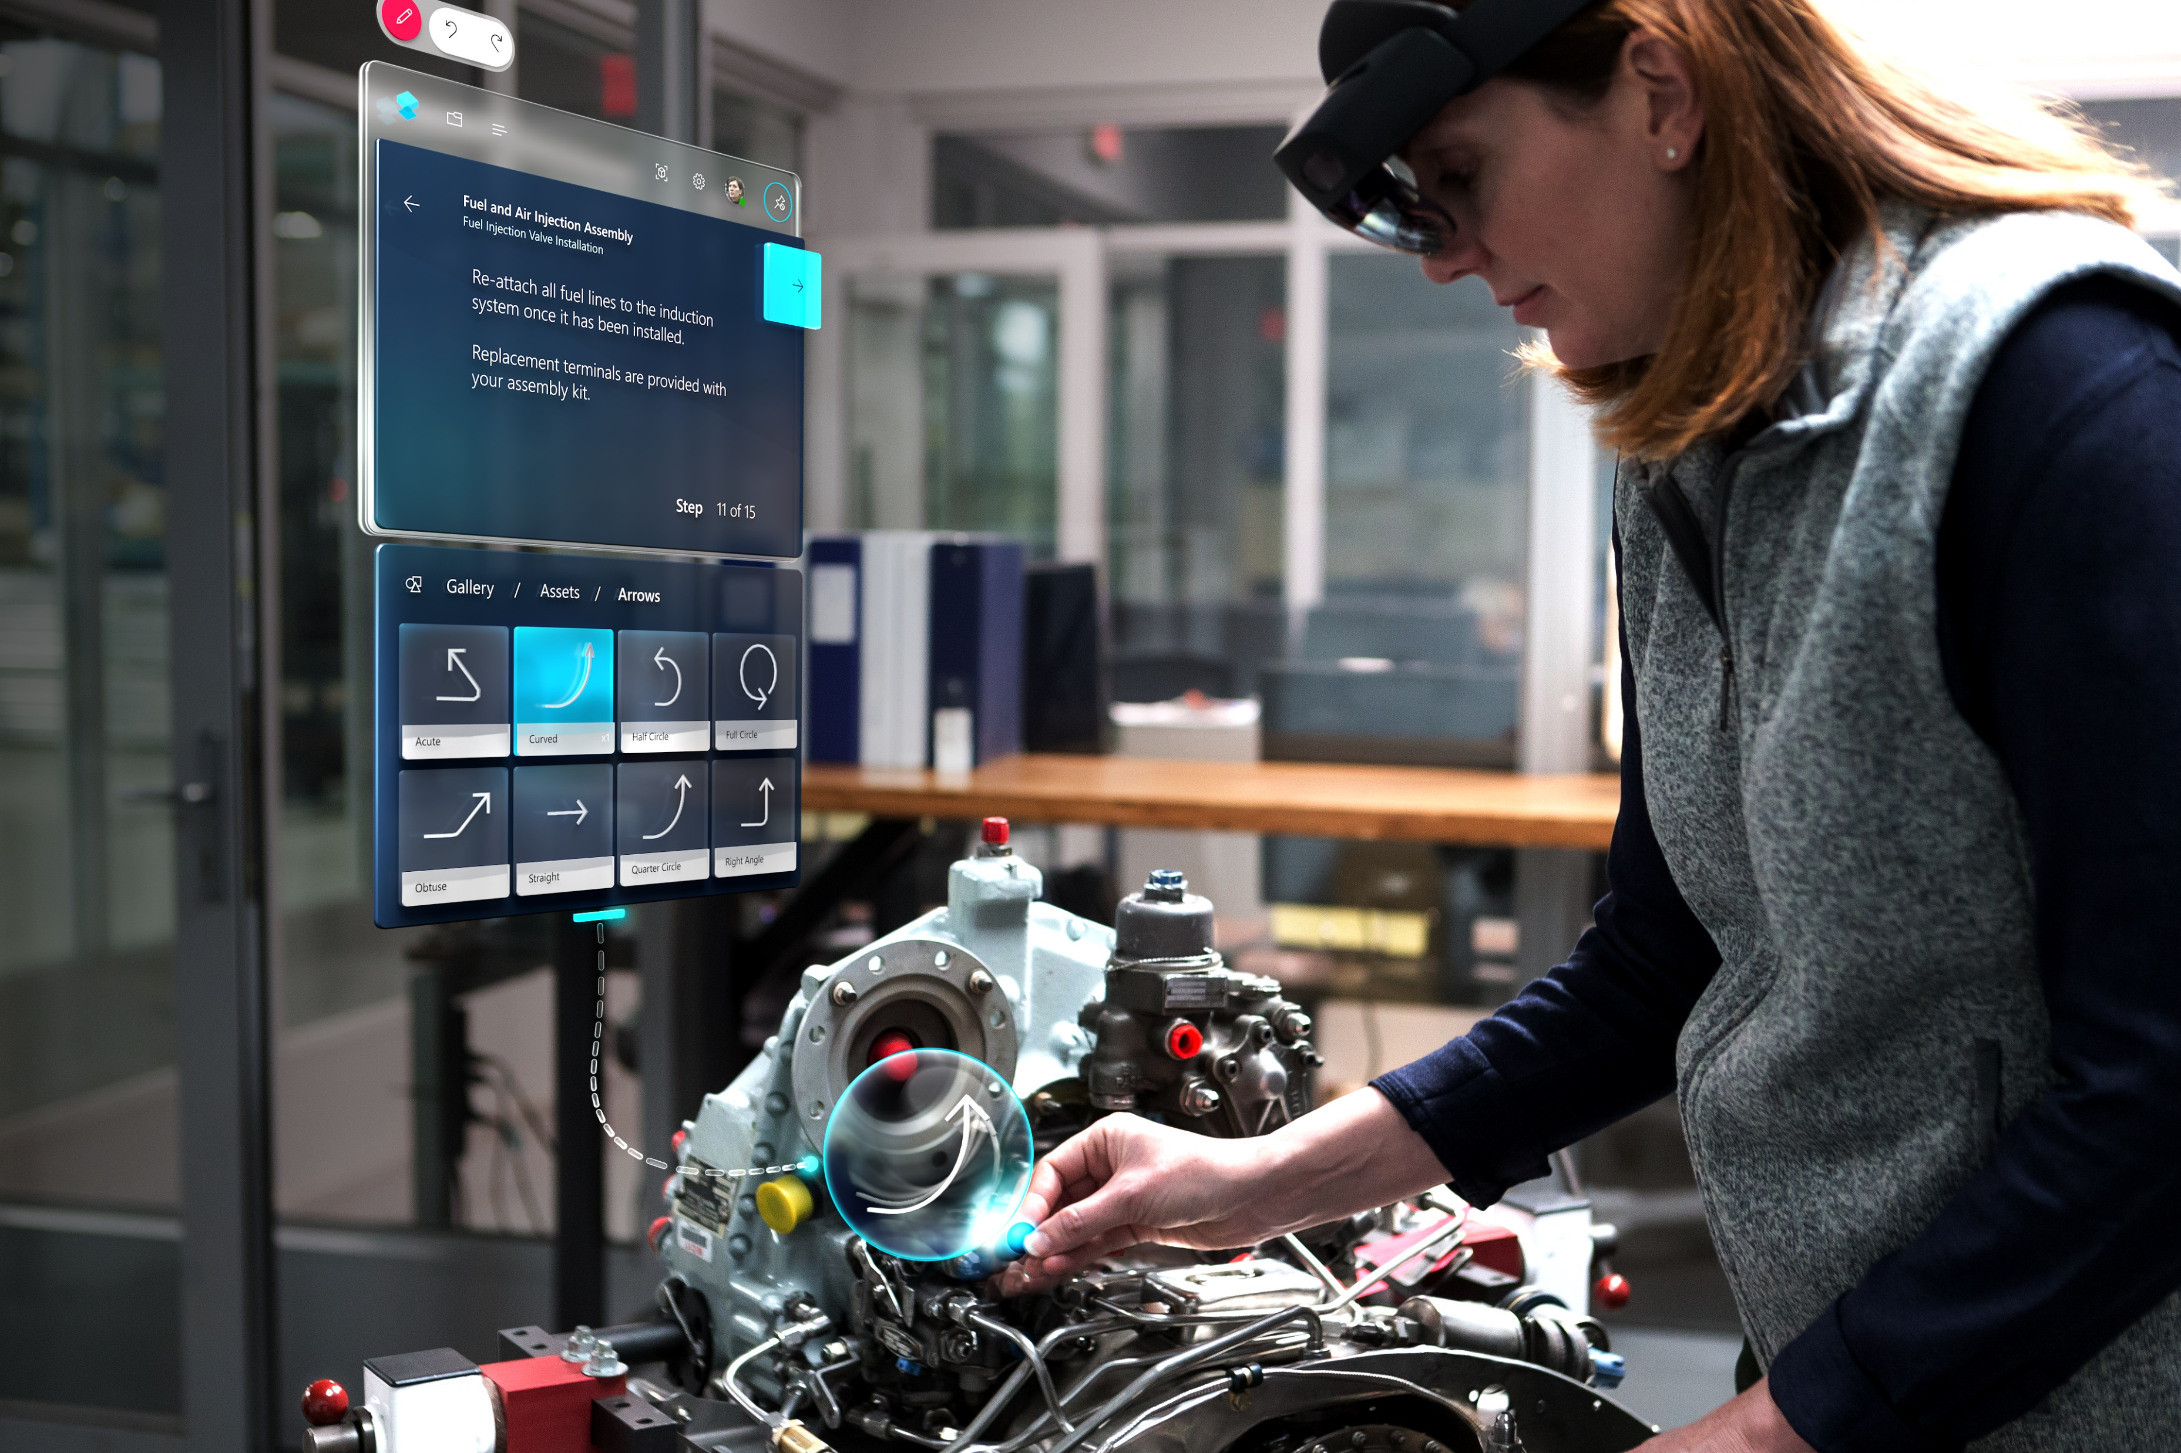
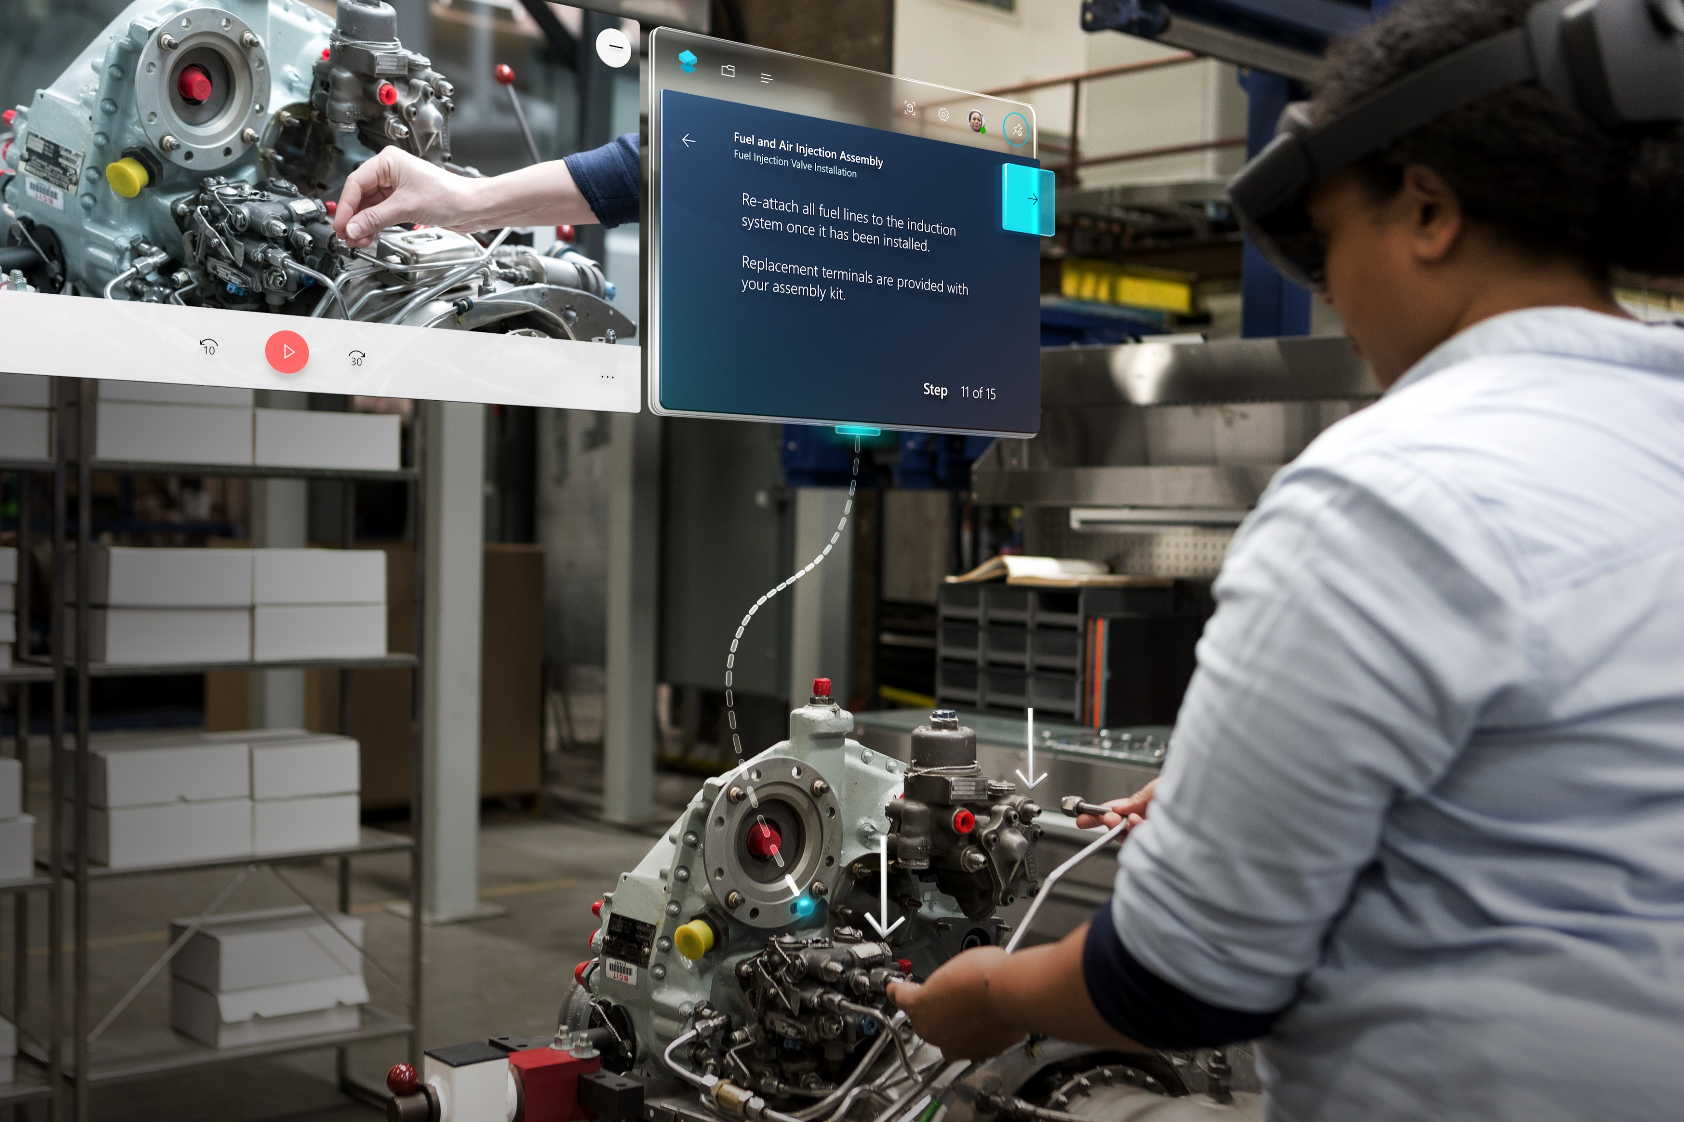


Workforce Transformation
Enhance operations with intelligent tools and applications
Extend Guides across core business functions
Assembly
Show employees the tools and parts they need and how to use them in real work situations.
Service
Equip technicians with guided instructions at the job site, eliminating the need to schedule additional visits.
Operations
Rollout new processes with increased consistency by turning employee knowledge into a repeatable tool.
Certification
Ensure every employee meets high standards by quickly identifying who needs help where.
Safety
Experience dangerous procedures virtually before attempting in the physical environment.
Unfamiliar equipment or process
Ongoing training
Standardization and compliance
Notes:
Slide title: Extend Guides across core business functions
Slide purpose: Show how Guides can be used across business functions. Our customers don’t just use Dynamics 365 Guides for training. From standardizing assembly processes, to servicing repairs and certifying employees on new equipment, this is what Guides can do for you. And across all these core business functions, we know you have new employees, new equipment, new process and ongoing training.
Key points:
Assembly: Show employees the tools and parts they need and how to use them in real work situations.
Service: Equip technicians with guided instructions at the job site, eliminating the need to schedule additional visits.
Operations: Rollout new processes with increased consistency by turning employee knowledge into a repeatable tool.
Certification: Ensure every employee meets high standards by quickly identifying who needs help where.
Safety: Experience dangerous procedures virtually before attempting in the physical environment.
Key products: Dynamics 365 Guides

Slide 26


Customer: Majans
Industry: Manufacturing
Size: 50–999 employees
Country: Australia
Products and services: Microsoft Dynamics 365 Dynamics 365 Supply Chain Management Microsoft Power BI
Read full story here
“What we find really exciting and empowering about our IoT Intelligence capabilities is that all our stakeholders now work from one set of numbers.”
—Amit Raniga, Director, Majans
Snack manufacturer Majans wanted to transform its production processes to meet lean manufacturing goals, improve snack food quality, increase production, and drive innovation to create snack magic for customers.
Majans implemented Microsoft Dynamics 365 Supply Chain Management and IoT Intelligence to turn data from IoT-enabled devices into actionable insights on the production line.
Majans is creating data‑driven manufacturing processes that extend from the farm to the factory to the consumer experience. It now provides its frontline workers, management, and C-level decision makers with near-real-time data offering meaningful signals and insights.

Slide 27

Accelerate getting started with Dynamics 365
Learn more > Enterprise Field Asset Maintenance: Reduce Cost, Improve Quality and Enhance Productivity
Let Microsoft help you define your business needs > Request a demo, trial, “In A Day Workshop” or contact us
Watch an event demo on maximizing asset uptime..
Connect frontline workers with experts > Video
Provide consistent levels of support > Video
Quick-Start Guide to Building Resiliency with Customers > Guide
You are likely dealing with new challenges and opportunities as a result of the current business environment.
Discover how we can help, request a demo, trial, or contact.
In this one-day hands-on engagement, a Microsoft Partner will build a sample crisis management solution for your business.
Using data from your business, you will receive a detailed assessment of the value a Dynamics 365 business applications solution could have on your business.
Notes:
[MSFT SELLERS] Ask these questions/use cases to understand your customer’s use case for Dynamics 365:
What are the top challenges you’re struggling to address in the wake of changes XXX

